Slide 1

ETEC-303 Digital Communication Lecture - 3
Instructor:
Abhishek Gagneja
Digital Communication Slides

Slide 2
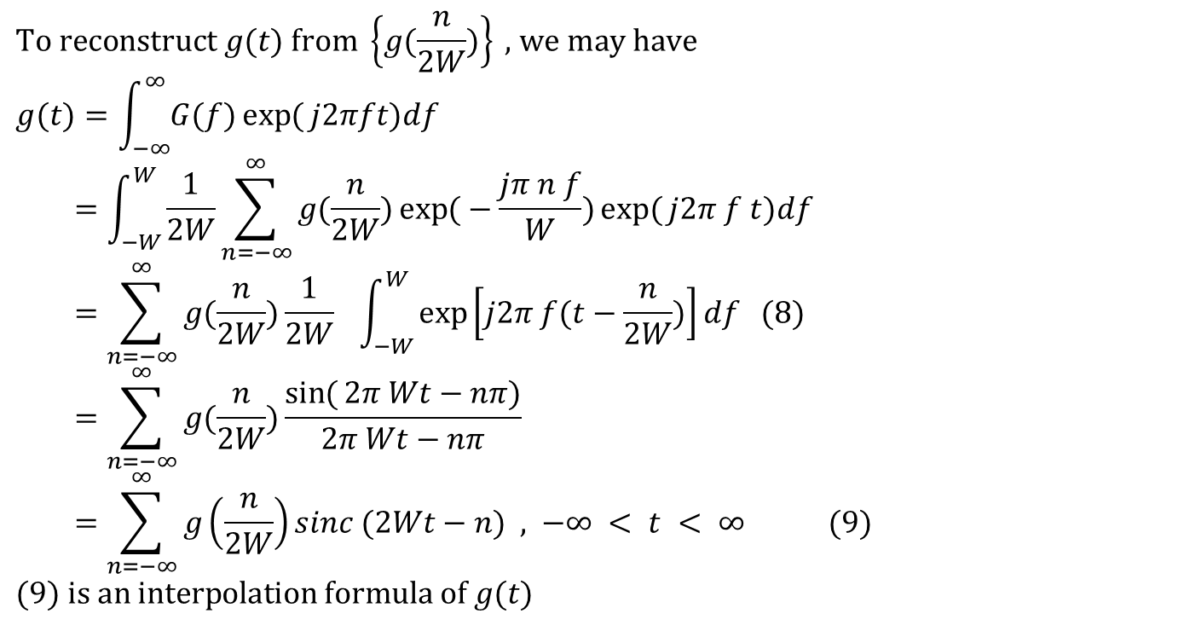
Interpolation Formula
$$\text{To} \text{reconstruct} g(t) \text{from} \left\{g(\frac{n}{2W})\right\}\text{ , }\text{we} \text{may} \text{have} \\ g(t)=\int_{−∞}^{∞}{G(f)\exp{(}j2πft)df} \\ =\int_{−W}^{W}{\frac{1}{2W}\sum_{n=−∞}^{∞}{g(\frac{n}{2W})\exp{(}−\frac{jπ n f}{W})\exp{(}j2π f t)df}} \\ =\sum_{n=−∞}^{∞}{g(\frac{n}{2W})\frac{1}{2W} \int_{−W}^{W}{\exp\left[j2π f(t−\frac{n}{2W})\right]df (8)}} \\ =\sum_{n=−∞}^{∞}{g(\frac{n}{2W})\frac{\sin{(}2π Wt−nπ)}{2π Wt−nπ} } \\ =\sum_{n=−∞}^{∞}{g\left(\frac{n}{2W}\right)sinc (2Wt−n)\text{ , −}∞ < t < ∞} (9) \\ (9) \text{is} \text{an} \text{interpolation} \text{formula} \text{of} g(t)$$
Digital Communication Slides

Slide 3
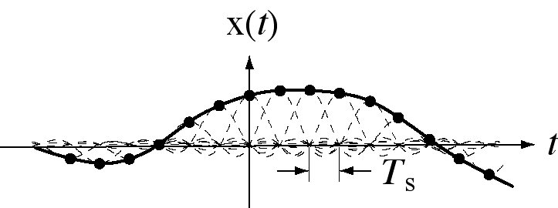
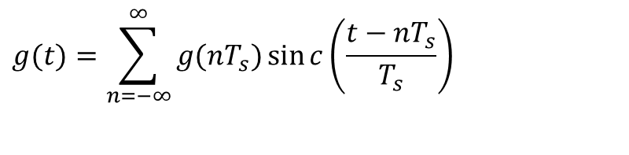
Interpolation
If the sampling is at exactly the Nyquist rate, then
$$g(t)=\sum_{n=−∞}^{∞}{g(nT_{s})\sin{c}\left(\frac{t−nT_{s}}{T_{s}}\right)}$$
Digital Communication Slides

Slide 4
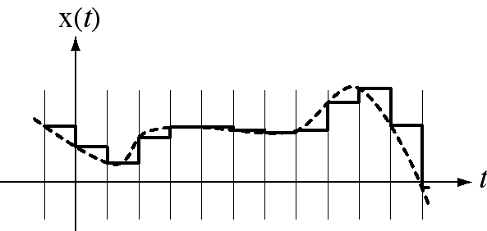

Practical Interpolation
Sinc-function interpolation is theoretically perfect but it can never be done in practice because it requires samples from the signal for all time. Therefore real interpolation must make some compromises. Probably the simplest realizable interpolation technique is what a DAC does.
$$g(t)$$
Digital Communication Slides

Slide 5
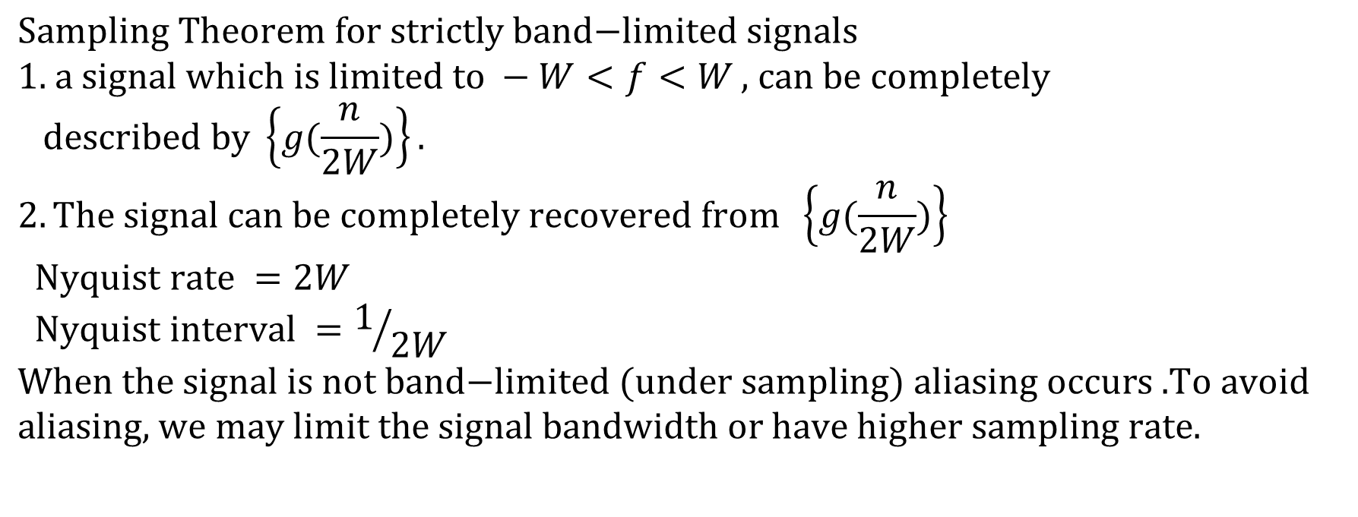
Sampling Theorem
$$\text{Sampling} \text{Theorem} \text{for} \text{strictly} \text{band}\text{−}\text{limited} \text{signals} \\ \text{1.} \text{a} \text{signal} \text{which} \text{is} \text{limited} \text{to} −W<f<W\text{ , }\text{can} \text{be} \text{completely} \\ \text{described} \text{by} \left\{g(\frac{n}{2W})\right\}. \\ 2.\text{The} \text{signal} \text{can} \text{be} \text{completely} \text{recovered} \text{from} \left\{g(\frac{n}{2W})\right\} \\ \text{Nyquist} \text{rate} =2W \\ \text{Nyquist} \text{interval} =1/{2W}$$ $\text{When} \text{the} \text{signal} \text{is} \text{not} \text{band}\text{−}\text{limited} (\text{under} \text{sampling}) \text{aliasing} \text{occurs}\text{ .}\text{To} \text{avoid} \text{aliasing}\text{, }\text{we} \text{may} \text{limit} \text{the}$ $\text{signal} \text{bandwidth} \text{or} \text{have} \text{higher} \text{sampling} \text{rate}\text{.}$
Digital Communication Slides

Slide 6
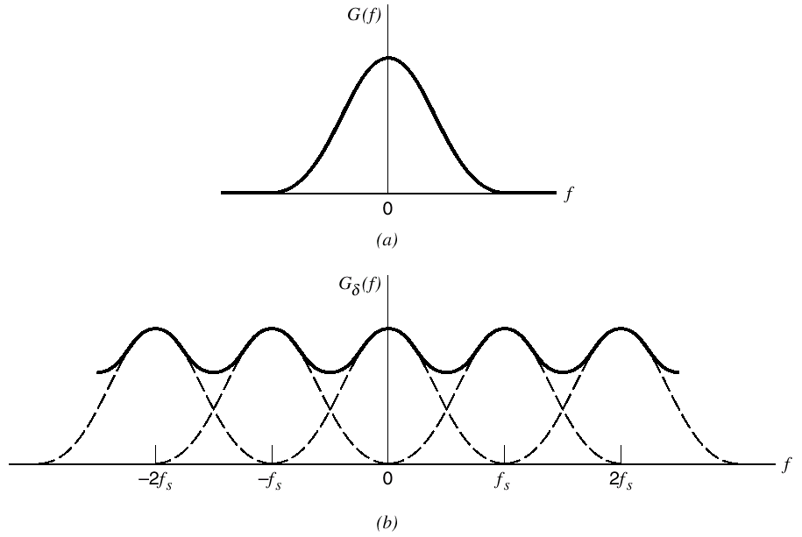
Under Sampling, Aliasing
Digital Communication Slides

Slide 7
Avoid Aliasing
Band-limiting signals (by filtering) before sampling.
Sampling at a rate that is greater than the Nyquist rate.
Anti-aliasing
filter
A/D
conversion
f_{s}(t)
f(t)
T
Sampling
Digital Communication Slides

Slide 8
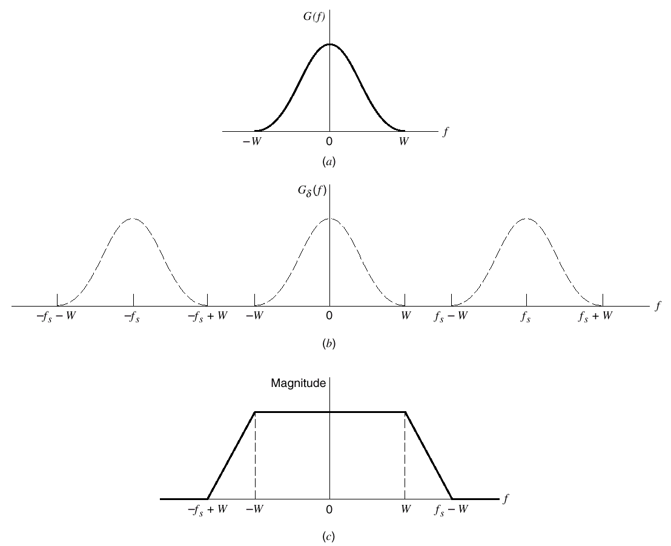
Anti-Aliasing
Digital Communication Slides

Slide 9
Natural sampling (Sampling with rectangular waveform)
Digital Communication Slides

Slide 10
Summary Of Sampling
Ideal Sampling
(or Impulse Sampling)
Natural Sampling
(or Gating)
Flat-Top Sampling
For all sampling techniques
If fs > 2B then we can recover x(t) exactly
If fs < 2B) spectral overlapping known as aliasing will occur
Digital Communication Slides

